Slide 1

Formation Machine Learning
Niveau Intermédiaire
Onesime Mbulayi
Le Coach

Slide 2
Machine Learning

Slide 3
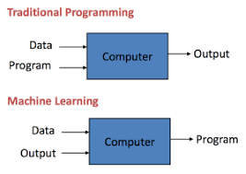
Machine Learning
Arthur Samuel, a pioneer in the field of artificial intelligence and computer gaming, coined the term “Machine Learning” as – “Field of study that gives computers the capability to learn without being explicitly programmed”.
How it is different from traditional Programming:
In Traditional Programming, we feed the Input, Program logic and run the program to get output.
In Machine Learning, we feed the input, output and run it on machine during training and the machine creates its own logic, which is being evaluated while testing.

Slide 4
Machine Learning
Model: A model is a specific representation learned from data by applying some machine learning algorithm. A model is also called hypothesis.
Feature: A feature is an individual measurable property of our data. A set of numeric features can be conveniently described by a feature vector. Feature vectors are fed as input to the model. For example, in order to predict a fruit, there may be features like color, smell, taste, etc.
Target(Label): A target variable or label is the value to be predicted by our model. For the fruit example discussed in the features section, the label with each set of input would be the name of the fruit like apple, orange, banana, etc.

Slide 5
Machine Learning
Training: The idea is to give a set of inputs(features) and it’s expected outputs(labels), so after training, we will have a model (hypothesis) that will then map new data to one of the categories trained on.
Prediction: Once our model is ready, it can be fed a set of inputs to which it will provide a predicted output(label).

Slide 6
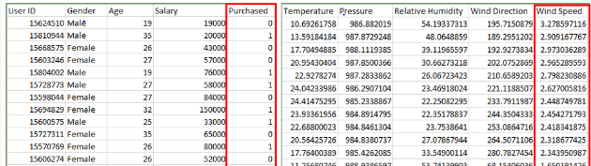
Machine Learning
Types of Learning
Supervised Learning
Unsupervised Learning
Semi-Supervised Learning
Supervised Learning: Supervised learning is when the model is getting trained on a labelled dataset. Labelled dataset is one which have both input and output parameters. In this type of learning both training and validation datasets are labelled as shown in the figures below.

Slide 7
Machine Learning
Types of Supervised Learning:
Classification
Regression
Classification : It is a Supervised Learning task where output is having defined labels(discrete value). For example in above Figure A, Output – Purchased has defined labels i.e. 0 or 1 ; 1 means the customer will purchase and 0 means that customer won’t purchase. It can be either binary or multi class classification. In binary classification, model predicts either 0 or 1 ; yes or no but in case of multi class classification, model predicts more than one class.
Example: Gmail classifies mails in more than one classes like social, promotions, updates, offers.
Regression : It is a Supervised Learning task where output is having continuous value.
Example in before regression Figure, Output – Wind Speed is not having any discrete value but is continuous in the particular range. The goal here is to predict a value as much closer to actual output value as our model can and then evaluation is done by calculating error value. The smaller the error the greater the accuracy of our regression model.

Slide 8
Example of Supervised Learning Algorithms:
Linear Regression
Nearest Neighbor
Gaussian Naive Bayes
Decision Trees
Support Vector Machine (SVM)
Random Forest

Slide 9
Unsupervised Learning:
Unsupervised learning is the training of machine using information that is neither classified nor labeled and allowing the algorithm to act on that information without guidance. Here the task of machine is to group unsorted information according to similarities, patterns and differences without any prior training of data. Unsupervised machine learning is more challenging than supervised learning due to the absence of labels.
Types of Unsupervised Learning:
Clustering
Association

Slide 10
Unsupervised Learning:
Clustering: A clustering problem is where you want to discover the inherent groupings in the data, such as grouping customers by purchasing behavior.
Association: An association rule learning problem is where you want to discover rules that describe large portions of your data, such as people that buy X also tend to buy Y.
Examples of unsupervised learning algorithms are:
k-means for clustering problems.
Apriori algorithm for association rule learning problems
The most basic disadvantage of any Supervised Learning algorithm is that the dataset has to be hand-labeled either by a Machine Learning Engineer or a Data Scientist. This is a very costly process, especially when dealing with large volumes of data. The most basic disadvantage of any Unsupervised Learning is that it’s application spectrum is limited.

Slide 11
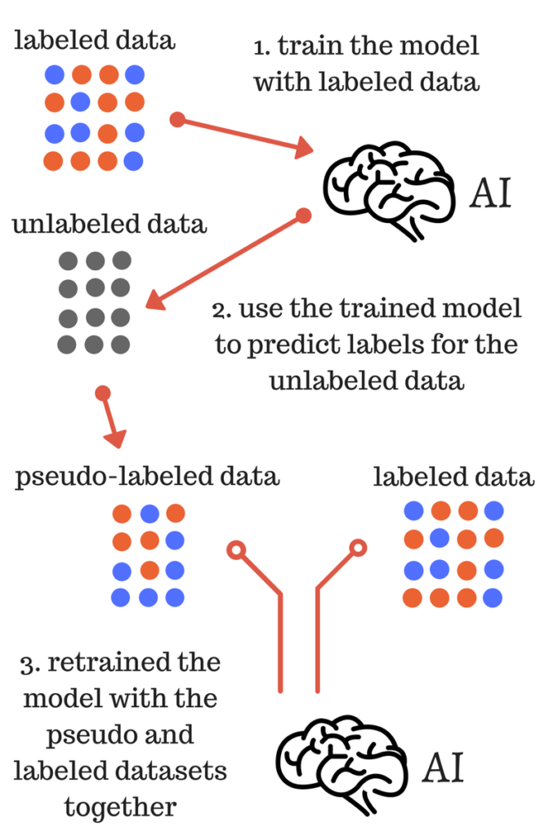
Semi-supervised machine learning:
To counter these disadvantages, the concept of Semi-Supervised Learning was introduced. In this type of learning, the algorithm is trained upon a combination of labeled and unlabeled data. Typically, this combination will contain a very small amount of labeled data and a very large amount of unlabeled data.
In semi supervised learning labelled data is used to learn a model and using that model unlabeled data is labelled called pseudo labelling now using whole data model is trained for further use

Slide 12
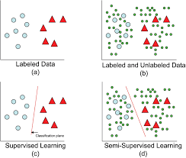
Model with labellled data and model with both labelled and unlabelled data
Intuitively, one may imagine the three types of learning algorithms as Supervised learning where a student is under the supervision of a teacher at both home and school, Unsupervised learning where a student has to figure out a concept himself and Semi-Supervised learning where a teacher teaches a few concepts in class and gives questions as homework which are based on similar concepts.

Slide 13
REGRESSION
Regression is a statistical measurement used in finance, investing, and other disciplines that attempts to determine the strength of the relationship between one dependent variable and a series of other changing variables or independent variable

Slide 14
REGRESSION
linear regression
Simple linear regression
Multiple linear regression
Polynomial regression
Decision tree regression
Random forest regression

Slide 15
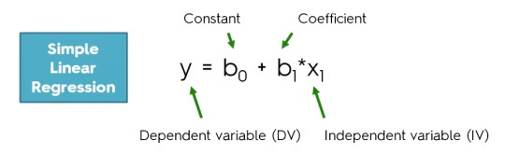
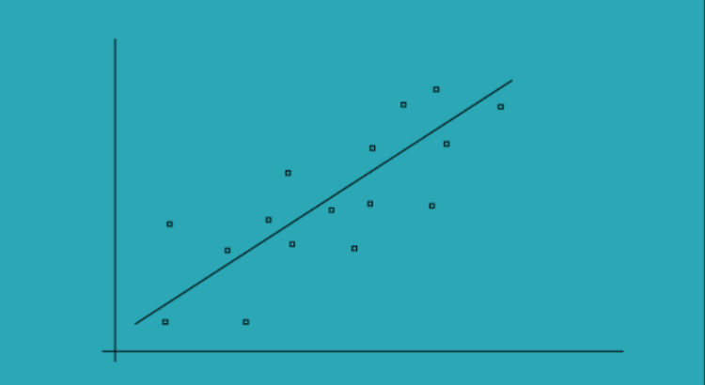
Simple Linear regression
The simple linear regression models are used to show or predict the relationship between the two variables or factors
The factor that being predicted is called dependent variable and the factors that is are used to predict the dependent variable are called independent variables
Simple Linear regression

Slide 16

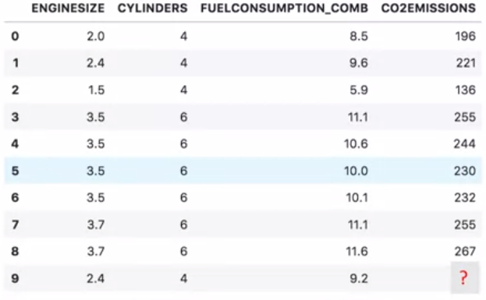
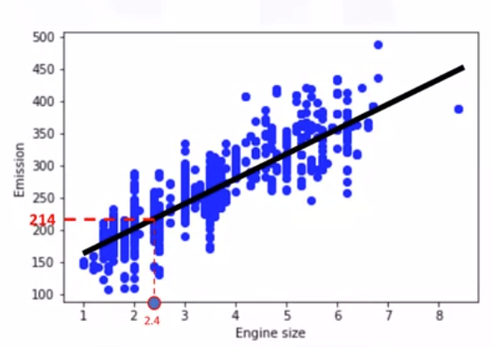
Predicting C02 emission with engine size feature using simple linear regression

Slide 17
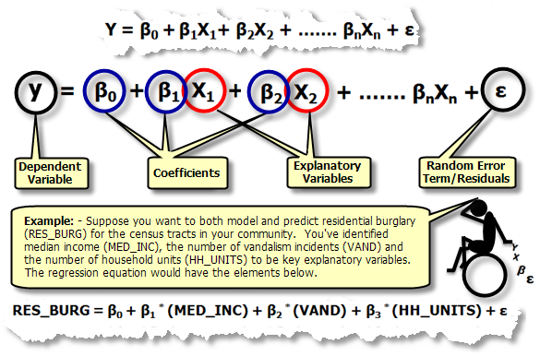
Multiple linear regression
Multiple regression is an extension of simple linear regression. It is used when we want to predict the value of a variable based on the value of two or more other variables. The variable we want to predict is called the dependent variable (or sometimes, the outcome, target or criterion variable).

Slide 18
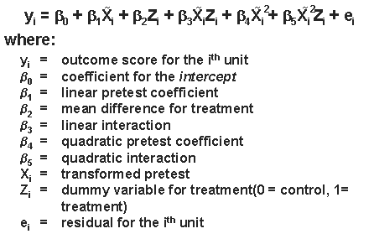
Polynomial regression
Polynomial Regression is a form of linear regression in which the relationship between the independent variable x and dependent variable y is modelled as an nth degree polynomial. Polynomial regression fits a nonlinear relationship between the value of x and the corresponding conditional mean of y, denoted E(y |x)

Slide 19
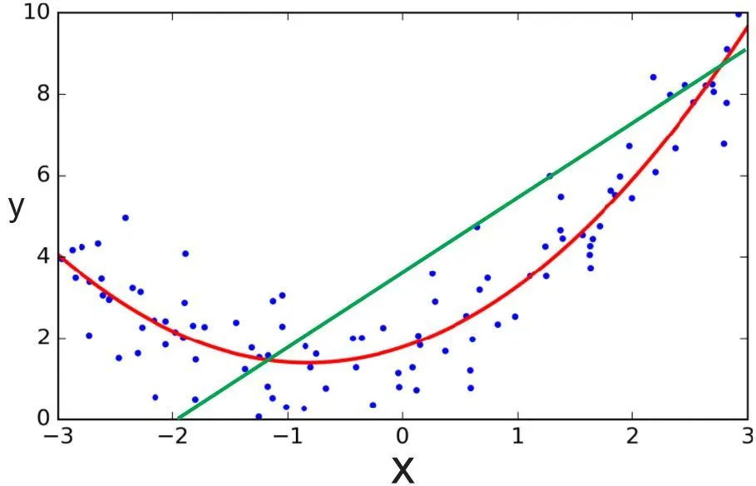
Polynomial regression

Slide 20
Decision tree regression
Decision tree builds regression models in the form of a tree structure. It breaks down a dataset into smaller and smaller subsets while at the same time an associated decision tree is incrementally developed. The final result is a tree with decision nodes and leaf nodes. A decision node (e.g., Outlook) has two or more branches (e.g., Sunny, Overcast and Rainy), each representing values for the attribute tested. Leaf node (e.g., Hours Played) represents a decision on the numerical target. The topmost decision node in a tree which corresponds to the best predictor called root node. Decision trees can handle both categorical and numerical data.

Slide 21
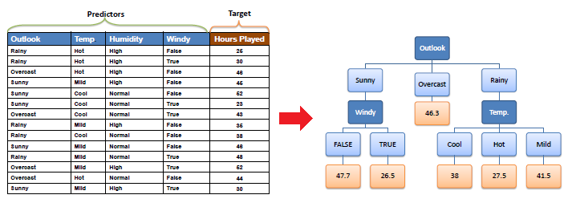
Decision tree regression

Slide 22
Decision tree regression
Decision tree regression observes features of an object and trains a model in the structure of a tree to predict data in the future to produce meaningful continuous output. Continuous output means that the output/result is not discrete, i.e., it is not represented just by a discrete, known set of numbers or values.
Discrete output example: A weather prediction model that predicts whether or not there’ll be rain in a particular day.
Continuous output example: A profit prediction model that states the probable profit that can be generated from the sale of a product.

Slide 23
Random forest regression
The Random Forest is one of the most effective machine learning models for predictive analytics, making it an industrial workhorse for machine learning.
The random forest model is a type of additive model that makes predictions by combining decisions from a sequence of base models. Here, each base classifier is a simple decision tree. This broad technique of using multiple models to obtain better predictive performance is called model ensembling. In random forests, all the base models are constructed independently using a different subsample of the data

Slide 24
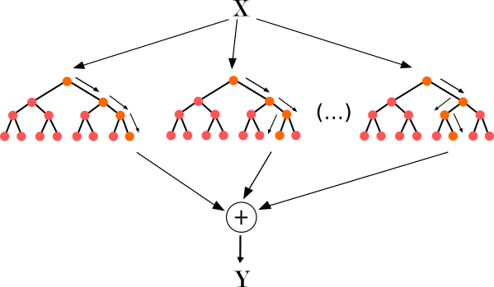
Approach :
Pick at random K data points from the training set.
Build the decision tree associated with those K data points.
Choose the number Ntree of trees you want to build and repeat step 1 & 2.
For a new data point, make each one of your Ntree trees predict the value of Y for the data point, and assign the new data point the average across all of the predicted Y values.

Slide 25
Pros and cons
Regression model | Pros | Cons
Linear regression | Works on any size of dataset, gives information about features. | The Linear regression assumptions.
Polynomial regression | Works on any size of dataset, works very well on non linear problems | Need to choose right polynomial degree for a. Good bias and trade off.
SVR | Easily adaptable, works very well on non linear problems, not biased by outliers | Compulsory to apply feature scaling, not well known ,more difficult to understand.
Decision tree recession | Interpretability ,no need for feature scaling ,works on both linear and non linear problems | Poor results on small datasets, overfitting can easily occur
Random forest regression | Powerful and accurate ,good performance many problems ,including non linear | No Interpretability , overfitting can easily occur, need to choose number of trees

Slide 26
LOGISTIC REGRESSION
In statistics, the logistic model is used to model the probability of a certain class or event existing such as pass/fail, win/lose, alive/dead or healthy/sick. This can be extended to model several classes of events such as determining whether an image contains a cat, dog, lion, etc
Based on the number of categories, Logistic regression can be classified as:
binomial: Target variable can have only 2 possible types: “0” or “1” which may represent “win” vs “loss”, “pass” vs “fail”, “dead” vs “alive”, etc.
multinomial: Target variable can have 3 or more possible types which are not ordered(i.e. types have no quantitative significance) like “disease A” vs “disease B” vs “disease C”.
ordinal: It deals with target variables with ordered categories. For example, a test score can be categorized as:“very poor”, “poor”, “good”, “very good”. Here, each category can be given a score like 0, 1, 2, 3.

Slide 27
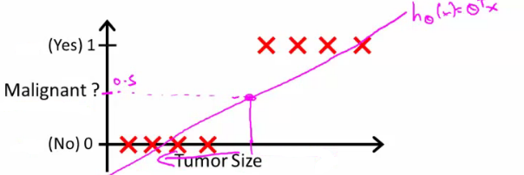
LOGISTIC REGRESSION
Start with binary class problems
How do we develop a classification algorithm?
Tumour size vs malignancy (0 or 1)
We could use linear regression
Then threshold the classifier output (i.e. anything over some value is yes, else no)
In our example below linear regression with thresholding seems to work

Slide 28


LOGISTIC REGRESSION
We can see above this does a reasonable job of stratifying the data points into one of two classes
But what if we had a single Yes with a very small tumour
This would lead to classifying all the existing yeses as nos
Another issues with linear regression
We know Y is 0 or 1
Hypothesis can give values large than 1 or less than 0
So, logistic regression generates a value where is always either 0 or 1
Logistic regression is a classification algorithm - don't be confused
Hypothesis representation
What function is used to represent our hypothesis in classification
We want our classifier to output values between 0 and 1
When using linear regression we did hθ(x) = (θT x)
For classification hypothesis representation we do hθ(x) = g((θT x))
Where we define g(z)
z is a real number
This is the sigmoid function, or the logistic function
If we combine these equations we can write out the hypothesis as

Slide 29
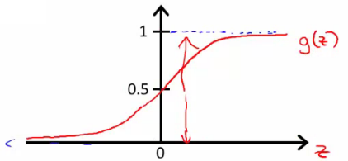
LOGISTIC REGRESSION
How does the sigmoid function look like
Crosses 0.5 at the origin, then flattens out]
Asymptotes at 0 and 1

Slide 30
Interpreting hypothesis output
When our hypothesis (hθ(x)) outputs a number, we treat that value as the estimated probability that y=1 on input x
Example
If X is a feature vector with x₀ = 1 (as always) and x₁ = tumourSize
hθ(x) = 0.7
Tells a patient they have a 70% chance of a tumor being malignant
hθ(x) = P(y=1|x ; θ)
What does this mean?
Probability that y=1, given x, parameterized by θ
Since this is a binary classification task we know y = 0 or 1
So the following must be true
P(y=1|x ; θ) + P(y=0|x ; θ) = 1
P(y=0|x ; θ) = 1 - P(y=1|x ; θ)

Slide 31
Interpreting hypothesis output
When our hypothesis (hθ(x)) outputs a number, we treat that value as the estimated probability that y=1 on input x
Example
If X is a feature vector with x₀ = 1 (as always) and x₁ = tumourSize
hθ(x) = 0.7
Tells a patient they have a 70% chance of a tumor being malignant
hθ(x) = P(y=1|x ; θ)
What does this mean?
Probability that y=1, given x, parameterized by θ
Since this is a binary classification task we know y = 0 or 1
So the following must be true
P(y=1|x ; θ) + P(y=0|x ; θ) = 1
P(y=0|x ; θ) = 1 - P(y=1|x ; θ)

Slide 32
Thank you for your attention
Onesime mbulayi

